Slide 1
Final Presentation of Machine Learning
Presented by,
Dhamina Sarvathikari
Tixa Hiteshkumar Patel

Slide 2
AGENDA
BUSINESS CASE- EXECUTIVE SUMMARY
ISSUE
ANTICIPATED OUTCOMES
RECOMMENDATION
JUSTIFICATION
USE-CASE MODEL
RISK ASSESSMENT & MITIGATION PLAN

Slide 3
BUSINESS CASE- EXECUTIVE SUMMARY
This business case outlines how the machine Learning Project will address current business concerns, the benefits of the project, and recommendations and justification of the project.
The business case also discusses detailed project goals, performance measures, assumptions, constraints, and alternative options.

Slide 4
ISSUE
An entire vehicle manufacturing involves lot of time in production. Any fault in any one of the parts of the vehicle can be very expensive.
In the manufacturing phase of vehicles, the process of identifying the root cause of an issue is lengthy and painstaking.
Massive amounts of testing data, sensor measurements, and manufacturer parameters are used in Root cause analysis. Performing with traditional methods can be time consuming and hard.
Machine Learning techniques will widely accelerate root cause analysis.

Slide 5
Anticipated Outcomes
Predictive analytics in machine Learning can be used to evaluate whether a flawed part can be reworked or needs to be scrapped.
The manufacturers of the parts can capture images of each component of the vehicle as it comes off the assembly line, and then automatically run the images through a machine learning model to identify any flaws.
Highly-accurate anomaly detection algorithms can detect issues down to a fraction of a millimetre.

Slide 6
Anticipated Outcomes
The same approach can be used for all component manufacturing as well as throughout the vehicle assembly line.
Anomaly detection algorithms can analyze vast amounts of system and driver data efficiently.
And they can perform this analysis using additional data types and in far greater quantities than traditional methods can handle.
Machine learning can provide far more precise and importantly evolving maintenance recommendations to help drivers protect their vehicle investment as well as their safety.

Slide 7
Recommendation
Accurate dataset containing hundreds or even thousands of parts images, each one tagged with information are required in order to implement an image recognition and analytics model, such as pass, fail, etc.
Image recognition and analytics models can play many roles in the automotive value chain like identifying and analysing the patterns to help in development of new and better performing tires, a proper control over quality of paint and other finishes and avoiding hazards in Automated Driving Systems.

Slide 8
Justification
With many issues rising , Machine Learning text recognition and Natural Language Processing allows the inclusion of service provider notes in the process of analysis.
Machine Learning can provide accurate and more precise solutions in helping the drivers in protecting their vehicles investment and also the safety of the drivers.
The predictive analytics model can continue to learn from its own performance data collected from the manufacturing processes and vehicles, unlike the traditional methods which are only updated a few times in a year.

Slide 9
USE-CASE MODEL
ML problem pattern is composed of building blocks.
Two basic types of building blocks are an input data and an output decision.
Input Data Block - images, structured data from a database, audio, text.
Output Decision Block - a classification, number, a similarity measure.

Slide 10
Use Case Model
For more complicated business problems, there are other types of blocks to consider, such as granularity block and an algorithm block.
Granularity block - how granular you want your prediction to be.
Algorithm block - which of the various algorithms apply to the problem.
ML problem patterns are modular in nature, so blocks can be added or removed interchangeably depending on the complexity of business problem.

Slide 11
Pattern 1
Input Data: Our input data is images of Automobile parts (images).
Algorithm: We’ll use an algorithm that’s good at learning time-based dependencies (LSTM – Long Short-Term Memory).
Granularity: We want to predict whether the parts of automobile is correct or not (Intra-Input).
Output Decision: We need to decide whether the auto part is correct or not (Class).

Slide 12
Pattern 2
Input Data: Our input data is measurements from sensors (Text).
Algorithm: We’ll use an algorithm that’s good at learning time-based dependencies ARIMA – Autoregressive Integrated Moving Average
Granularity: We want to predict whether the measurements from sensors are correct or not (Intra-Input).
Output Decision: We need to decide whether the sensor data is correct or not (Class).

Slide 13
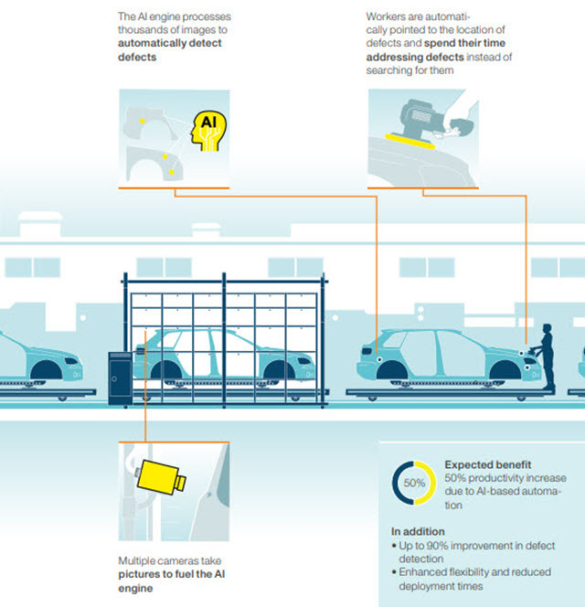
SCENARIO

Slide 14
RISK ASSESSMENT & MITIGATION PLAN
Increased Online Security
Anomaly Detections
Improving the Quality of Algorithms Used
Knowing the context and the implications
Context in data collection
Clean out training data
Perform ethical hacking
Encrypt security logs
Algorithm impact analysis
Tools for assessing bias and supporting ethical engineering

Slide 15
Budget
Total Cost For Annual Year - $ 6,89,600
Cost includes the following
Data Collection, Training Data Quality and Quantity, Validating, Cleaning and Labelling the Data Samples
Analysis and Research Phase
latency free machine learning inference
Virtual Machine
Machine Learning Developer
Maintenance Cost

Slide 16
Conclusion
Reduce cost on traditional methods
94% of fatal crashes in road traffic are due to the human error this can be avoided by autonomous vehicles by machine learning.
Object detection with Machine learning can be a safer solution for pedestrians running into the vehicles.
Any faults in the device can be identified while running or before the manufacturing which could stop accidents from occurring.
Machine learning change the products of auto mobility into more reliable products. Invest in Machine Learning for a healthier and a safer future.

Slide 17
References
https://squadex.com/insights/top-machine-learning-use-cases-business/amp/
Parks, J. (2020, June 4). How to identify machine learning use cases in your business. AgileThought. https://agilethought.com/blogs/how-to-identify-machine-learning-business-use-case/
Estimating the Time, Cost, & Deliverables of an ML App (appinventiv.com)

Slide 18

Thank You

